Slide 1


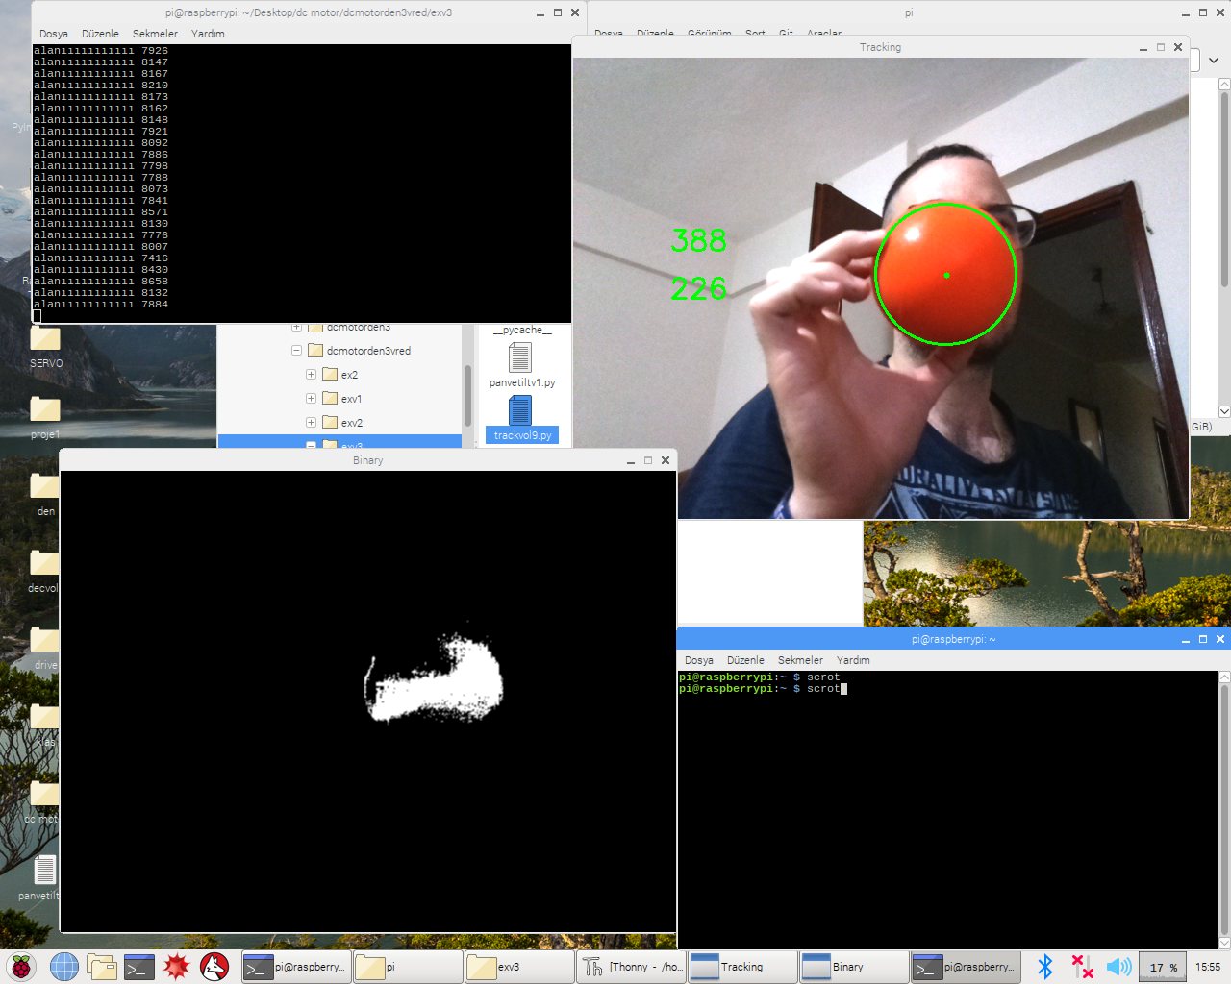
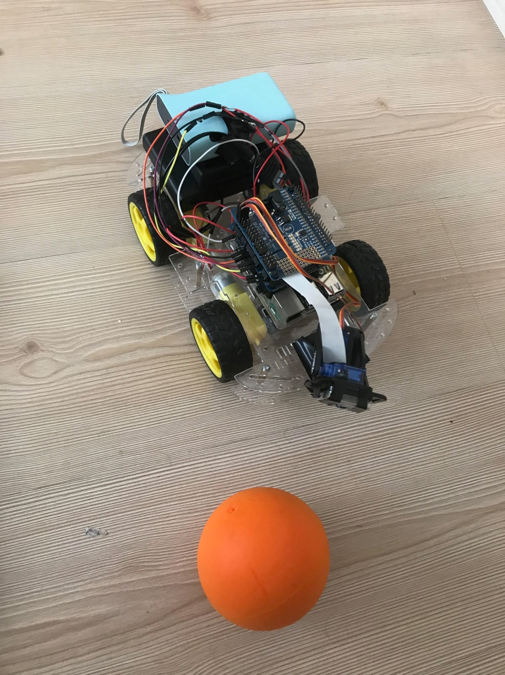
OBJECT TRACKER AUTONOMOUS ROBOT
DR. MERAL BAYRAKTAR
14066603 Azizhan Azizoğlu
Summary
Moving object detection techniques can be divided into two categories based on the type of the camera which is either static or active. Methods of static cameras can detect moving objects according to the variable regions on the video frame.. The aim of this thesis work is real time detection and tracking of moving objects with an active camera. For this purpose, object and function based algorithms are implemented due to the computational efficiency .An algorithm is developed in Python environment and OpenCV library. The developed algorithm is capable of detecting and tracking moving objects by using a PT (Pan-Tilt) camera at a frame rate of approximately 12 fps and with a resolution of 640x480. Moreover navigating a mobile robot and detecting distance by a active camera.
Picture 2 Computer Vision of The Tracker Robot
In the above picture, the image processing part is tried to be shown. As can be seen in the computer vision sees object in binary form. Thus, the object is distinguished from other objects in the environment. Later on, it draws a border around it and finds its center point.
Results
Fast growing in the world, embedded systems, we begin to see next to each of our lives. Especially with the inception of the age of knowledge, the machines have begun to be intelligent. Intelligent machines start to communicate with each other (iot) and became one step closer to people's ability to do that. In this thesis, it is aimed to get away from the technologies which are left from the classical industrial revolution and to enter the age of information. In here, the vision ability of the machines is discussed. (computer vision). A machine, like a human being, can see and decide. As a result, a predetermined object is searched and founded by an intelligent autonomous robot.
Picture 1 The Object Tracker Autonomous Robot
The robot consists of 5 basic parts as seen in the picture. It means a lowest portion of the chassis is disposed. Inside the chassis there is a DC Motor for each individual. Above the chassis, Raspberry Pi is placed to make the necessary computer operations. On Raspberry Pi, controller cards for DC motor and servos are added. The batteries are in the backmost part and the camera is in the front part.

